Slide 1

CHHATTISGARH SWAMI VIVEKANAND TECHNICAL
UNIVERSITY
LIBRARY MANAGEMENT SYSTEM WEBSITE
Guided By
Bharti Patel
Assistant professor
CSVTU,Bhilai
Submitted By
Dolly Sahu, Madhurima Rawat and
Geetanshu dev Meshram
300012821034, 300012821042 and 300012821043

Slide 2
Introduction
The library management system has been developed to override the problems prevailing in the practicing manual system .
The website is reduced as much as possible to avoid errors by entering the data. No formal knowledge is needed for the user to use this website.Thus by all this it proves it is user friendly.
First as described above library management system can lead to error free secure reliable and fast management system it can assist the user to concentrate on their other activities rather than to concentrate on the record keeping

Slide 3
Outline
Managing a library comes with unique challenges, and librarians are always looking for ways to be more efficient and improve their processes.
Library management software makes it easy to manage library databases and records, and automate activities such as cataloging, lending, fundraising, managing book donations, and more.
Another key benefit of library management tools is that they make life easier for library users.
Most of the tools we’re discussing here have a front-facing user dashboard where library users can set up their own accounts, discover new books, read online, or borrow materials.

Slide 4



Methodology/ Planning of work
First we have developed a user friendly and responsive interface through frontend .All visual features, pixels and cross browser compatibility will be taken in account.
Frontend Development- HTML,CSS and BOOTSTRAP
We have made the website design simple and easy to work with along with an attractive interface.

Slide 5
Front – End Methodology
One of the primary goals of frontend development is to create a smooth or "frictionless" user experience.
In other words, the front end of an application or website should be intuitive and easy to use. While this sounds like a simple goal, it can be surprisingly complex since not all users or devices are the same.
For example, an app developed for a mobile device requires a significantly different frontend than a desktop application.
Websites must work well on multiple devices and screen sizes, which is why modern web development typically involves responsive design.

Slide 6
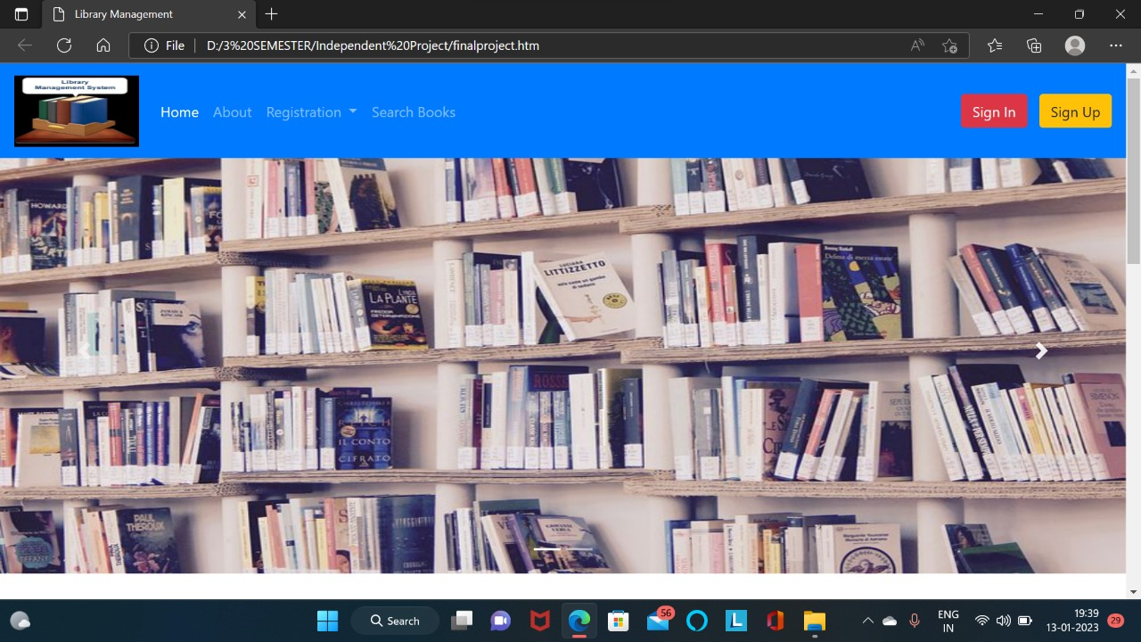
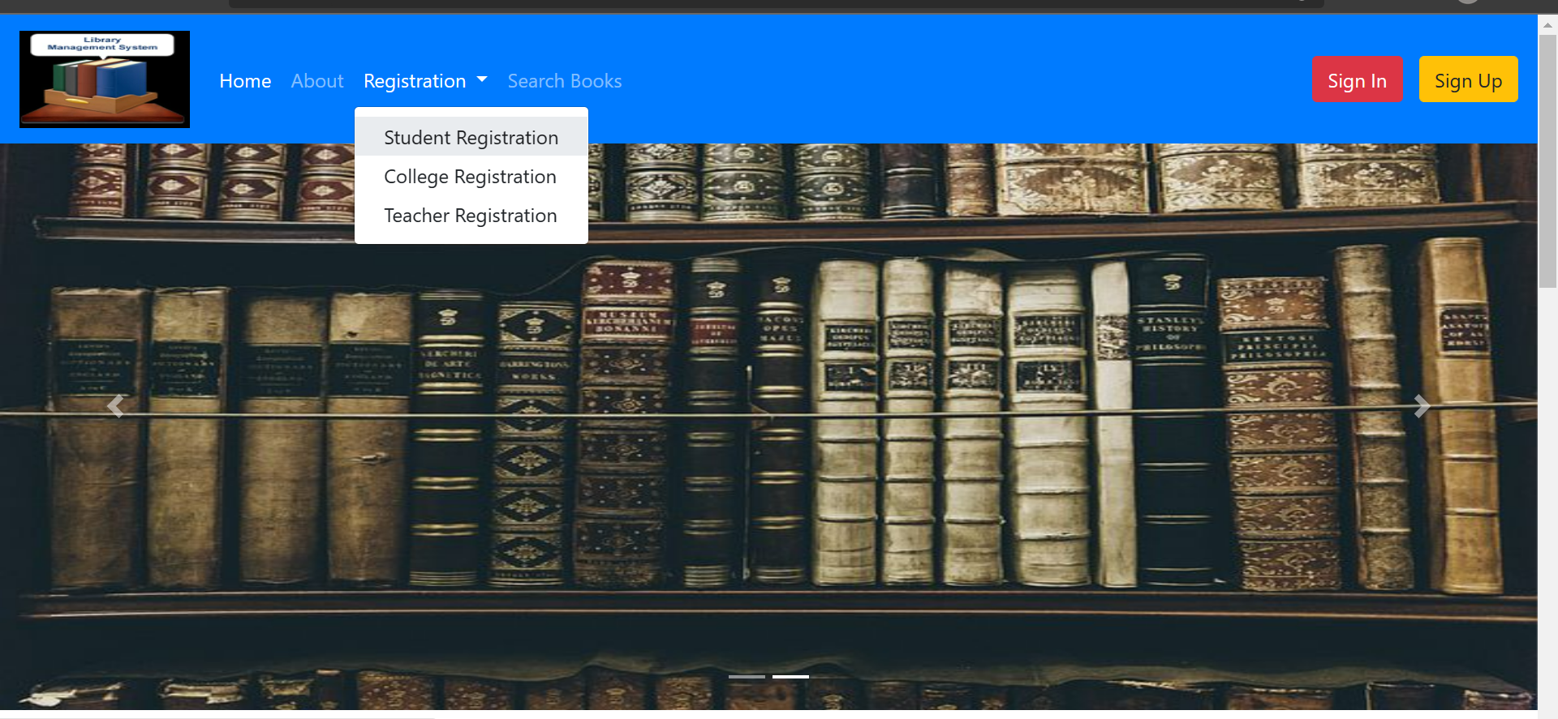
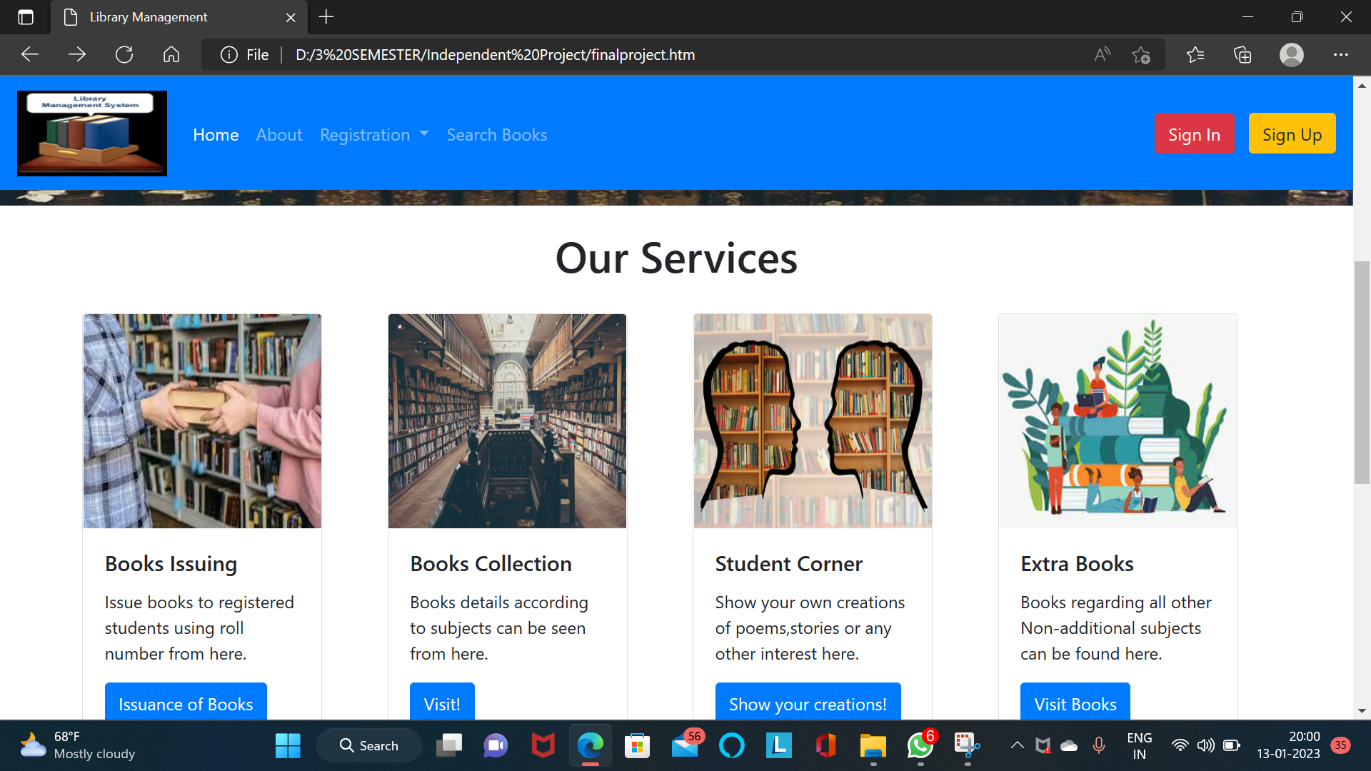
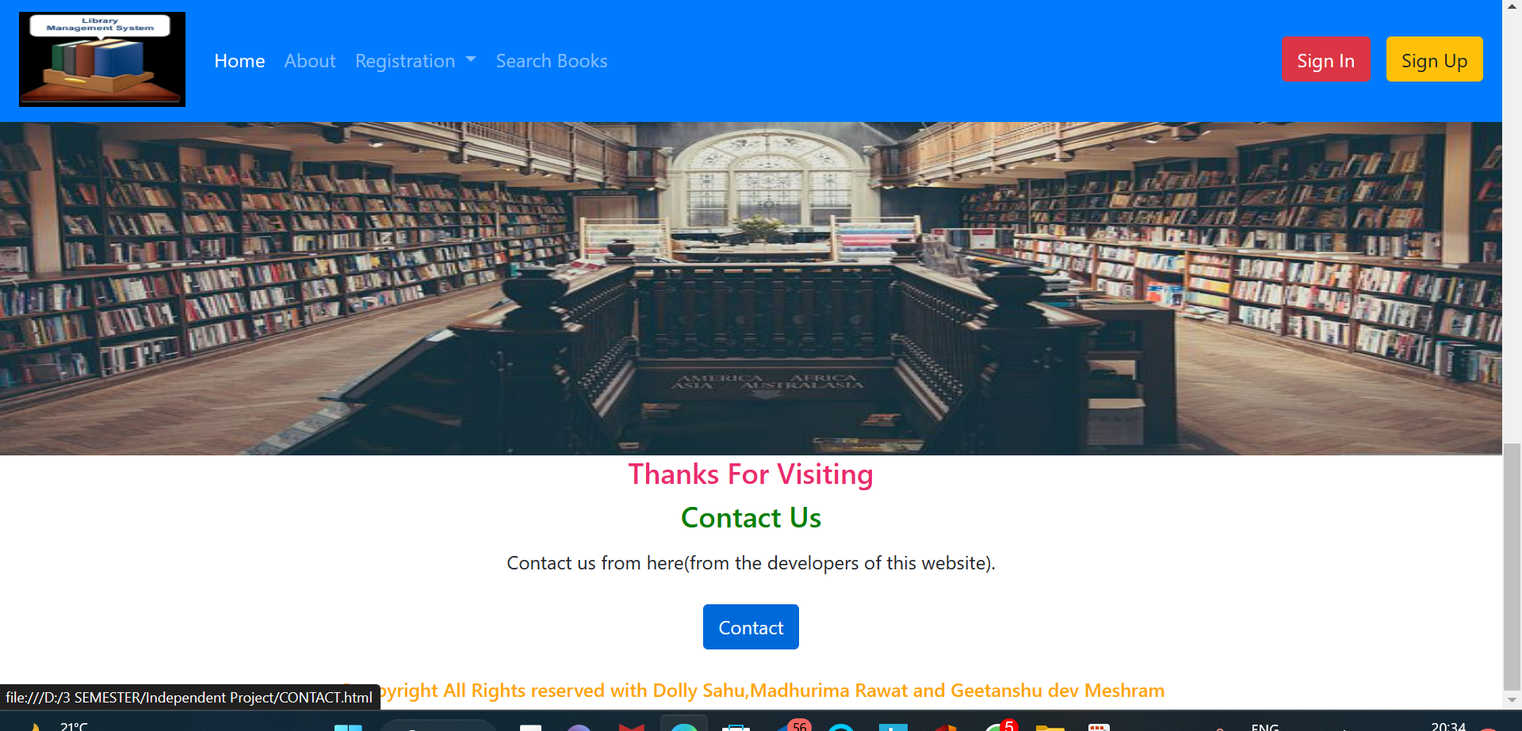
Output- Design of website

Slide 7



Back-end
For storing data from front-end/website we have develop back-end
For backend we create database in XAMPP server.
With the help of MariaDB and MYSQL we have stores all the from form our website .
For that purpose we use PHP (hypertext preprocessor) language that takes data from html and store into the MySQL.

Slide 8
Back – End Methodology
The Back-end refers to parts of a computer application or a program’s code that allow it to operate and that cannot be accessed by a user.
Most data and operating syntax are stored and accessed in the back end of a computer system.
A back-end application or program supports front-end user services, and interfaces with any required resources.
The back-end application may interact directly with the front end or it may be called from an intermediate program that mediates front-end and back-end activities.
Back-end developers ensure the website performs correctly, focusing on databases, back-end logic, application programming interface (APIs), architecture, and servers.

Slide 9
How back-end works in our project ?
First in web browser (front-end) user enters there details in forms and then php retrieve that data and send it into database.
Php
Html form
database

Slide 10
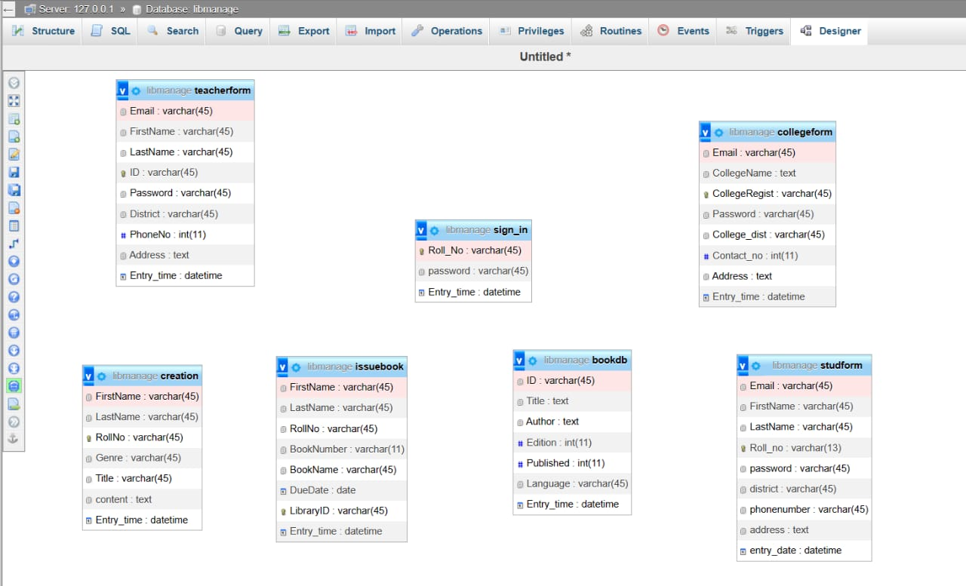
Backend Overview

Slide 11
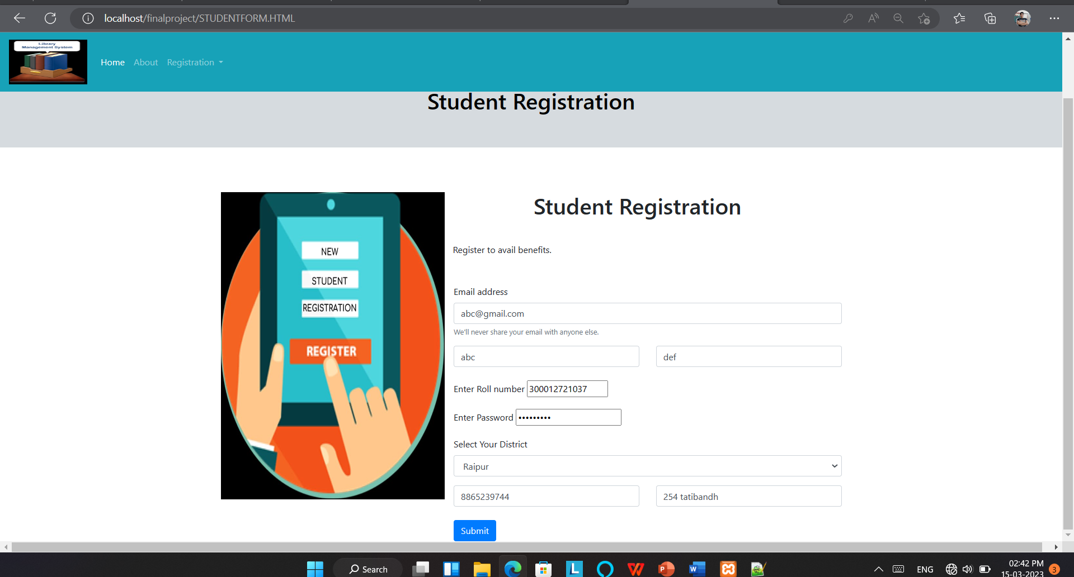
Front end View

Slide 12
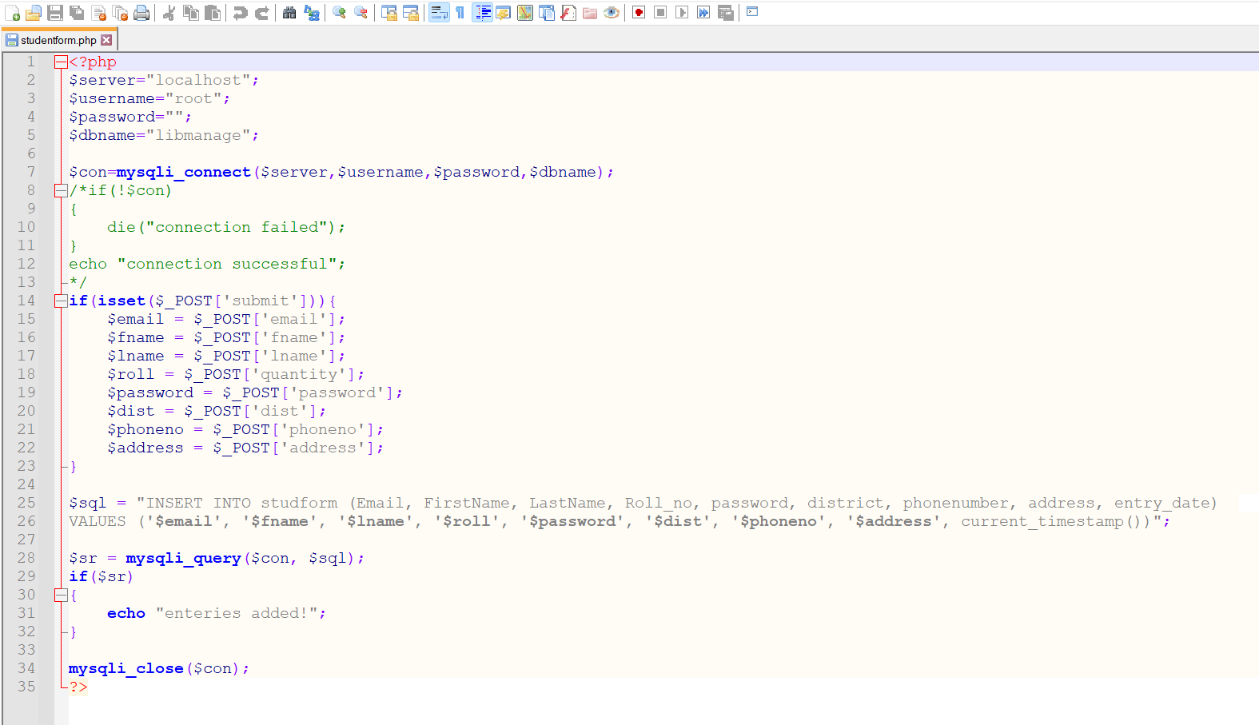
PHP code

Slide 13
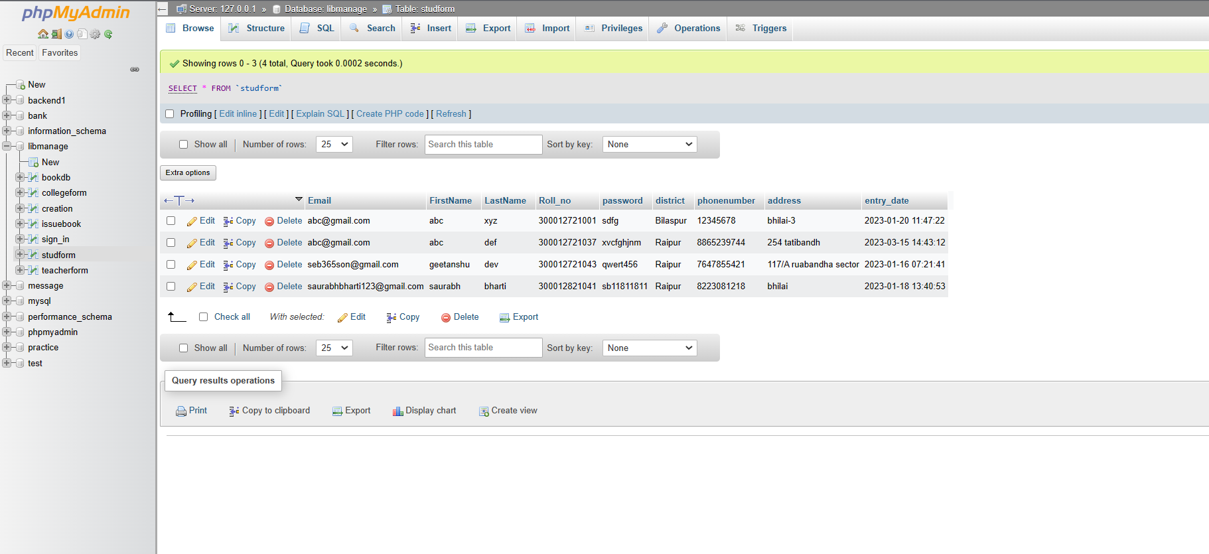
Output Backend

Slide 14
References
For Introduction:- Studocu
Link-334841496 Synopsis of Library Management System - Synopsis of Library Management System Page No. - Studocu
For Literature survey :- Wikipedia
Link- Library management - Wikipedia
For Frontend development:-
Bootstrap- Get started with Bootstrap · Bootstrap v5.3 (getbootstrap.com)
For Backend development:-
Xampp server- XAMPP Installers and Downloads for Apache Friends

Slide 15
THANK YOU FOR LISTENING TO OUR PRESENTATION
Any questions?

